Slide 1
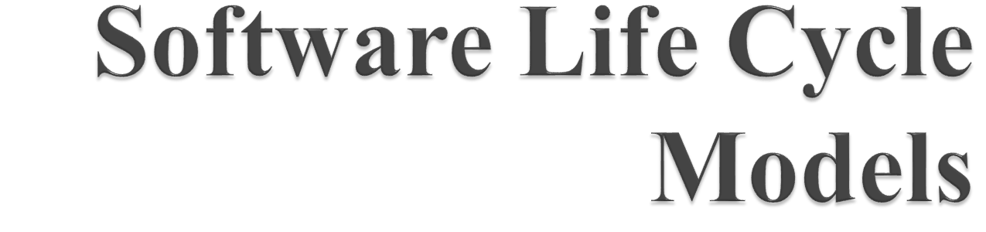

Slide 2

Use of Life Cycle Models
Software is developed through several well-defined stages:
      Requirement analysis and specification,
      Design,
      Coding
      Testing, etc.

Slide 3
Emphasis has shifted
  From error correction to error prevention
  Modern practices emphasize:
  Detection of errors as close to their point of introduction as possible

Slide 4
In exploratory style
  Errors are detected only during testing
  Now:
  Focus is on detecting as many errors as possible in each phase of development

Slide 5
In exploratory style
  Coding is synonymous with program development
  Now:
  Coding is considered only a small part of program development effort

Slide 6
A lot of effort and attention is now being paid to:
  Requirements specification
  Also, now there is a distinct design phase:
  Standard design techniques are being used

Slide 7
During all stages of development process:
  Periodic reviews are being carried out
  Software Testing has become systematic:
  Standard testing techniques are available

Slide 8
There is better visibility of design and code:
  visibility means production of good quality, consistent and standard documents
  In the past, very little attention was being given to producing good quality and consistent documents
  We will see later that increased visibility makes software project management easier

Slide 9
Projects are being properly planned:
  estimation
  Scheduling
  Monitoring mechanisms
  Use of CASE Tools

Slide 10

A descriptive and diagrammatic model of software life cycle
Identifies all the activities undertaken during product development
Establishes a precedence ordering among the different activities
Divides life cycle into phases.

Slide 11

Helps common understanding of activities among the software developers
Helps to identify inconsistencies, redundancies, and omissions in the development process

Slide 12

When a program is developed by a single programmer
  The problem is within the grasp of an individual
  He has the freedom to decide his exact steps and still succeed ---- called exploratory model --- one can use it in many ways
  Code -> Test -> Design
  Code -> Design -> Test -> change code
  Specify -> code -> design -> test -> etc.

Slide 13
When software is being designed by a team:
  There must be a precise understanding among team members as to when to do what
  Otherwise, it would lead to chaos and project failure

Slide 14

A life cycle model:
  Defines entry and exit criteria for every phase
  A phase is considered to be complete:
      Only when all its exit criteria are satisfied

Slide 15
The ultimate objective of software engineering is to produce good quality maintainable software within reasonable time frame and at affordable cost.
Life cycle of a software starts from the concept exploration and ends at the retirement of the software.
The software life cycle typically includes a requirement phase, design phase, implementation phase, test phase, installation and check out phase, operation and maintenance phase, and sometimes retirement phase.

Slide 16
A software life cycle model is a particular abstraction that represents a software life cycle.
A software life cycle model is often called a software development life cycle (SDLC).
A variety of life cycle models have been proposed and are based on tasks involved in developing and maintaining software.

Slide 17

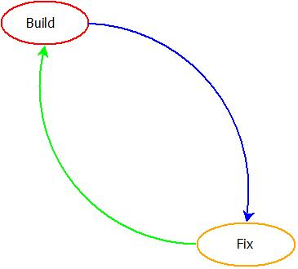

Slide 18

Sometimes, a product is constructed without specifications or any attempt at design. Instead, the developer simply builds a product that is reworked as many times as necessary to satisfy the client.
This is an adhoc approach and not well-defined. Basically, it is a simple two-phase model. The first phase is to write code and the next phase is to fix it.
Fixing in this context may be error correction or addition of further functionality.

Slide 19
May work well on small programming exercises 100 or 200 lines long but totally unsatisfactory for software of any reasonable cost.
Code soon becomes unfixable and unenhanceable.

Slide 20

The most familiar model.
The model has five phases.
The phases always occur in this order and do not overlap.
The developer must complete each phase before the next phase begins.

Slide 21

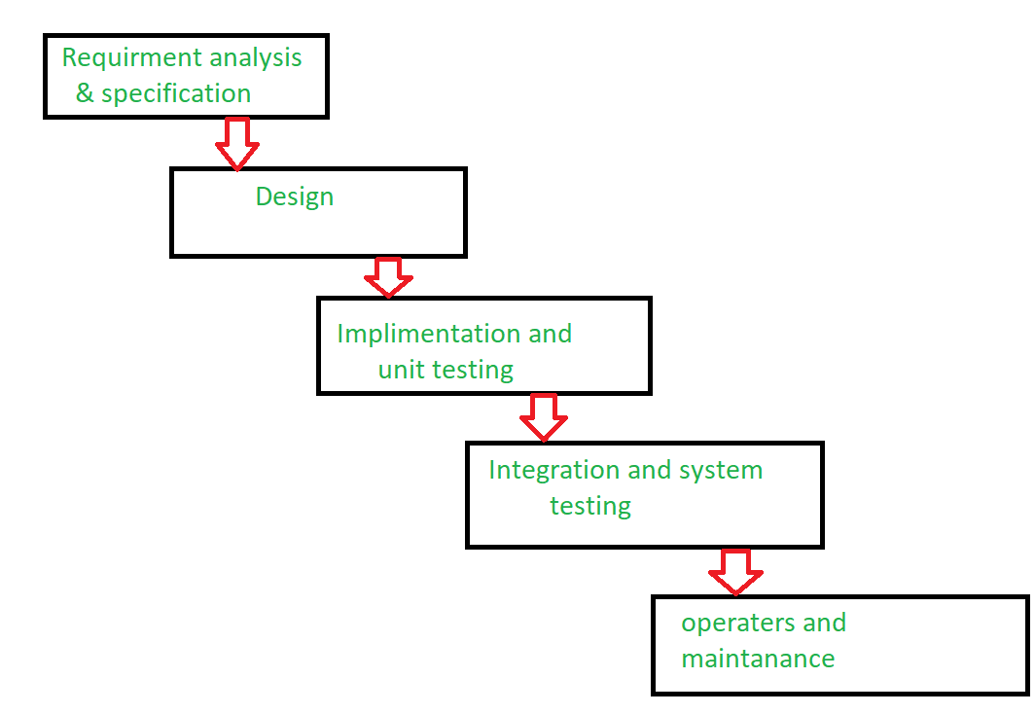

Slide 22
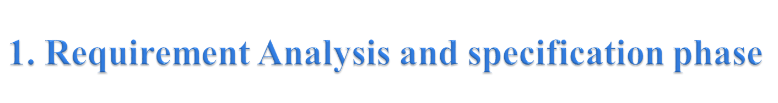
The main goal of this phase is to understand the exact requirements of the customer and to document them properly.
The activity is executed together with the customer.
The output of this phase is a large document written in a natural language describing what the system will do without describing how it will be done.
The resultant document is known as Software Requirement Specification (SRS) document.

Slide 23

The goal of this phase is to transform the requirements specification into a structure that is suitable for implementation in some programming language.
Here, overall software architecture is defined, and the high level and detailed design work is performed.
This work is documented and known as Software Design Description (SDD) document.

Slide 24
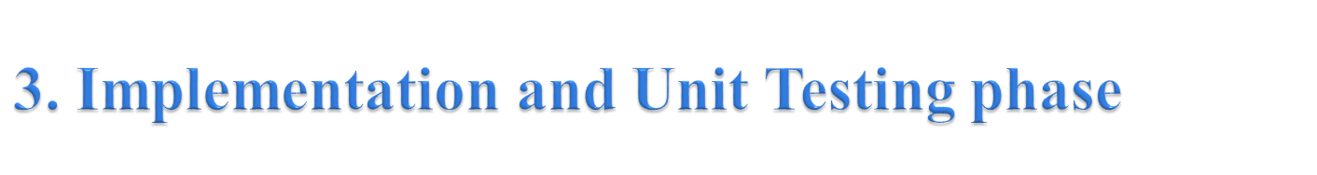
During this phase, design is implemented.
If the SDD is complete, the implementation or coding phase proceeds smoothly.
During testing, the major activities are centered around the examination and modification of the code.
Initially, small modules are tested in isolation from the rest of the software product.

Slide 25

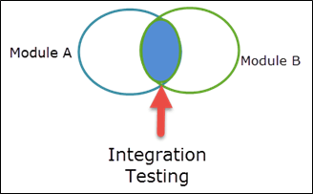
Very Important phase.
Effective testing will contribute to the delivery of higher quality software products, more satisfied users, lower maintenance costs, and more accurate and reliable results.
Very expensive activity. Consumes one-third to one-half of the cost of a typical development project.

Slide 26

The task which comes into play when the software is delivered to the customer’s site, installed and is operational.
This phase includes error correction, enhancement of capabilities, deletion of obsolete capabilities, and optimization.
The purpose of this phase is to preserve the value of the software over time.

Slide 27

It is difficult to define all requirements at the beginning of a project.
This model is not suitable for accommodating any change.
A working version of the system is not seen until late in the project’s life.
It does not scale up well to large projects.
Real projects are rarely sequential.

